Slide 1


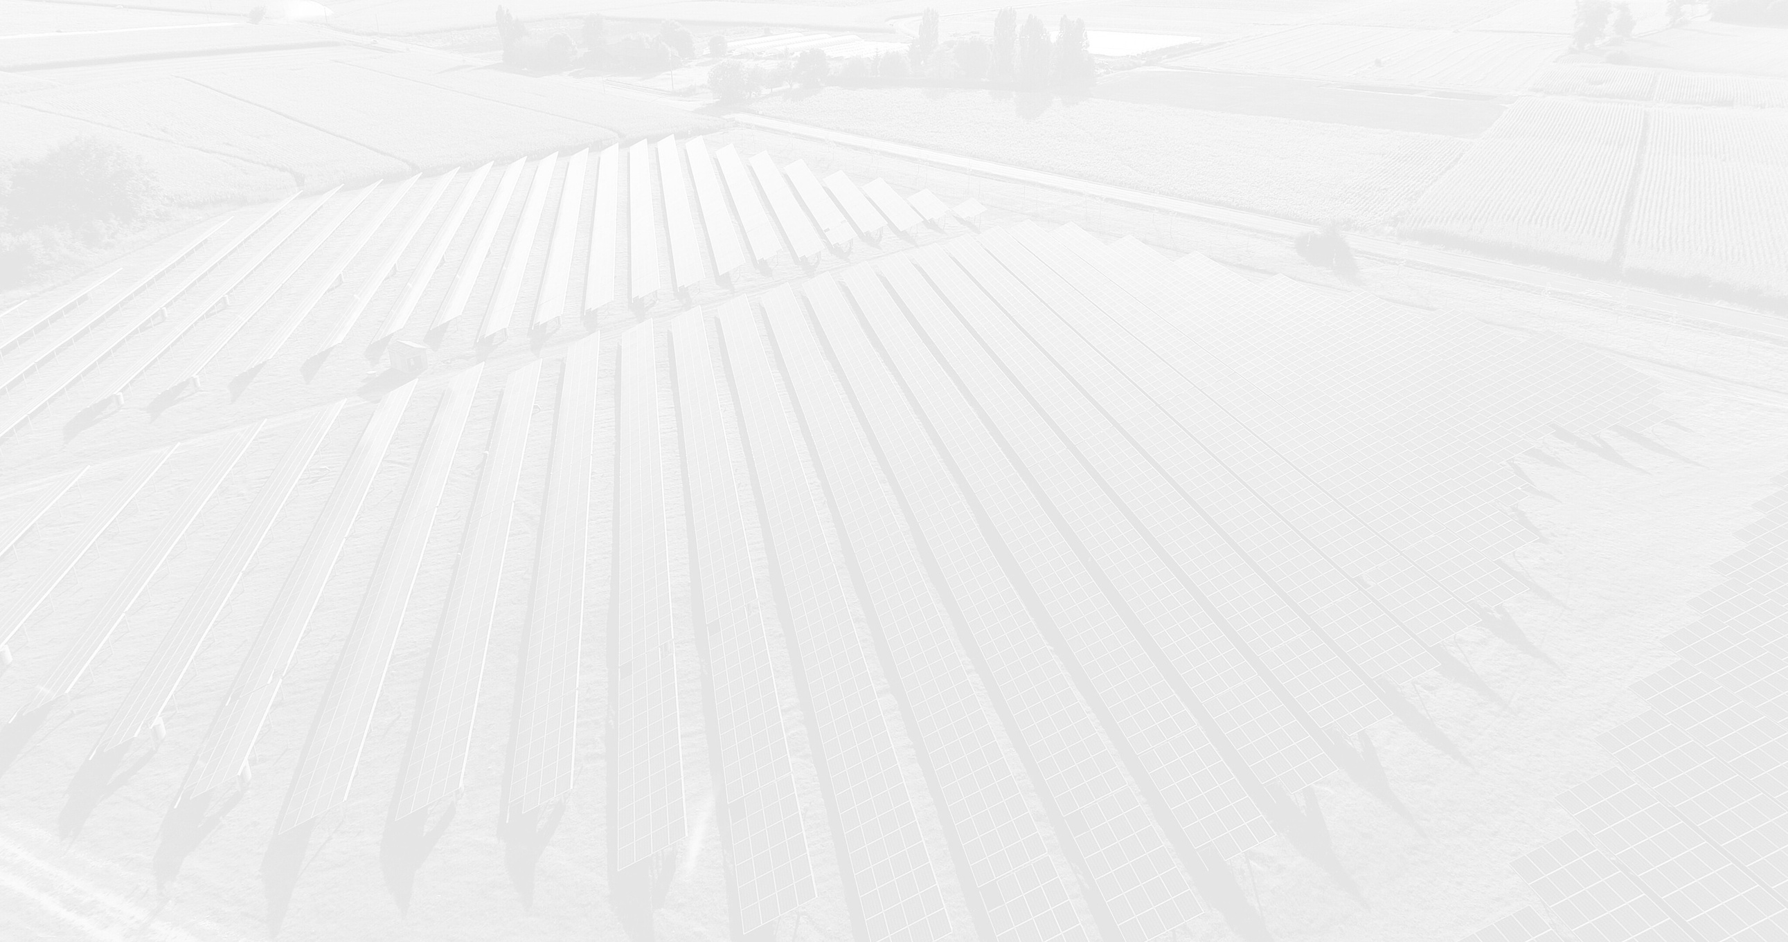


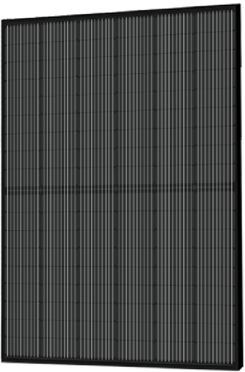








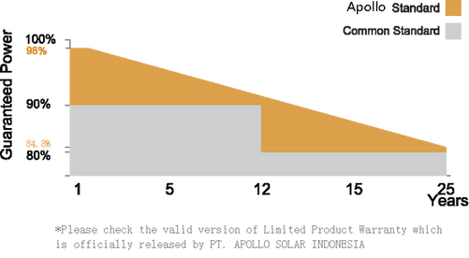


APM7-SH108 (390-405W)
APM7-SH108 Series
Key Features
10BB HALF-CELL Black Monocrystalline PERC PV Module
Excellent Cells Efficiency
MBB Technology reduce the distance between busbars and finger grid line which is benefit to power increase.
390-405W
20.74%
0.55`%
Anti PID
POWER RANGE
MAXIMUM EFFICIENCY
YEARLY DEGRADATION
Ensured PID resistance through the quality control of cell manufacturing process and raw materials.
Improved Aesthetics
12 YEARS PRODUCT WARRANTY
25 YEARS OUTPUT GUARANTEE
Compared to conventional modules, this full black modules have a more uniform apperance and superior aesthetics.
Better Weak Illumination Response
More power output in weak light condition, such as haze, cloudy, and early morning.
Adapt To Harsh Outdoor Environment
IEC 61215/IEC 61730
ISO 14001: Emvironmental Management System
ISO 9001: Quality Management System
ISO45001: Occupational Health and Safety Management System
Resistant to harsh environment such as salt, ammonia sand, high temperature and high humidity envirnment.
Excellent Quality Management System
Warranted reliability and stringent quality assurance well beyond certified requirements.
*As there are different certification requirements in different markets. Please contact your local Apollo sales representative for the specific certificates applicable to the products in the region in which the products are to be used.
KarMiTECH POWER

Slide 2

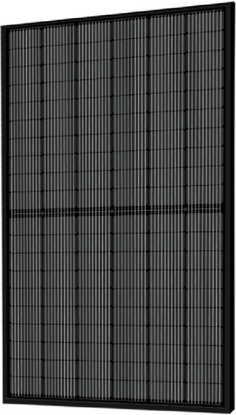
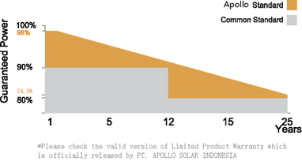
APM7-SH120 (435-440W)
APM7-SH120 Series
Key Features
10BB HALF-CELL Black Monocrystalline PERC PV Module
Excellent Cells Efficiency
MBB Technology reduce the distance between busbars and finger grid line which is benefit to power increase.
435-450W
20.85%
0.55%
Anti PID
POWER RANGE
MAXIMUM EFFICIENCY
YEARLY DEGRADATION
Ensured PID resistance through the quality control of cell manufacturing process and raw materials.
Improved Aesthetics
12 YEARS PRODUCT WARRANTY
25 YEARS OUTPUT GUARANTEE
Compared to conventional modules, this full black modules have a more uniform apperance and superior aesthetics.
Better Weak Illumination Response
More power output in weak light condition, such as haze, cloudy, and early morning.
Adapt To Harsh Outdoor Environment
IEC 61215/IEC 61730
ISO 14001: Emvironmental Management System
ISO 9001: Quality Management System
ISO45001: Occupational Health and Safety Management System
Resistant to harsh environment such as salt, ammonia sand, high temperature and high humidity envirnment.
Excellent Quality Management System
Warranted reliability and stringent quality assurance well beyond certified requirements.
*As there are different certification requirements in different markets. Please contact your local Apollo sales representative for the specific certificates applicable to the products in the region in which the products are to be used.
KarMiTECH POWER

Slide 3

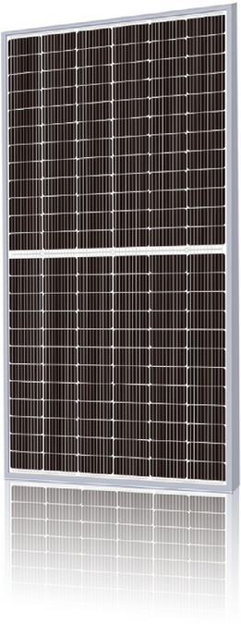

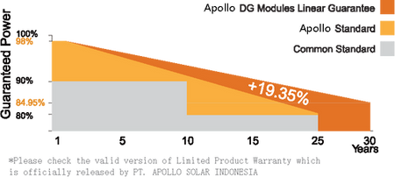

APM7-SHLDD144 (530-555W)
APM-SHLDD144 Series
Key Features
10BB HALF-CELL Double Glass Monocrystaliline PERC PV Module
Excellent Cells Efficiency
MBB Technology reduce the distance between busbars and finger grid line which is benefit to power increase.
535-555W
21.48%
0.45%
Anti PID
POWER RANGE
MAXIMUM EFFICIENCY
YEARLY DEGRADATION
Ensured PID resistance through the quality control of cell manufacturing process and raw materials.
12 YEARS PRODUCT WARRANTY
30 YEARS OUTPUT GUARANTEE
Excellent Quality Management System
Warranted reliability and stringent quality assurance well beyond certified requirements.
Better Weak Illumination Response
IEC 61215/IEC 61730/IEC 61701/IEC 62716/UL6 1730
ISO 14001: Emvironmental Management System
ISO 9001: Quality Management System
ISO45001: Occupational Health and Safety Management System
More power output in weak light condition, such as haze, cloudy, and early morning.
Adapt To Harsh Outdoor Environment
Resistant to harsh environment such as salt, ammonia sand, high temperature and high humidity envirnment.
*As there are different certification requirements in different markets. Please contact your local Apollo sales representative for the specific certificates applicable to the products in the region in which the products are to be used.
KarMiTECH POWER

Slide 4
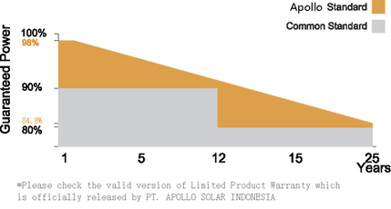
APM7-SH144 (530-555W)
APM7-SH144 Series
Key Features
10BB HALF-CELL Monocrystalline PERC PV Module
Excellent Cells Efficiency
MBB Technology reduce the distance between busbars and finger grid line which is benefit to power increase.
530-555W
21.48%
0.55`%
POWER RANGE
MAXIMUM EFFICIENCY
YEARLY DEGRADATION
Anti PID
Ensured PID resistance through the quality control of cell manufacturing process and raw materials.
12 YEARS PRODUCT WARRANTY
25 YEARS OUTPUT GUARANTEE
Excellent Quality Management System
Warranted reliability and stringent quality assurance well beyond certified requirements.
Better Weak Illumination Response
IEC 61215/IEC 61730
ISO 14001: Emvironmental Management System
ISO 9001: Quality Management System
ISO45001: Occupational Health and Safety Management System
More power output in weak light condition, such as haze, cloudy, and early morning.
Adapt To Harsh Outdoor Environment
*As there are different certification requirements in different markets. Please contact your local Apollo sales representative for the specific certificates applicable to the products in the region in which the products are to be used.
Resistant to harsh environment such as salt, ammonia sand, high temperature and high humidity envirnment.
KarMiTECH POWER

Slide 5

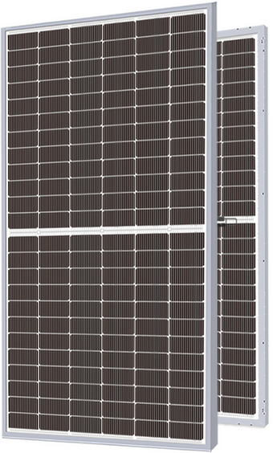


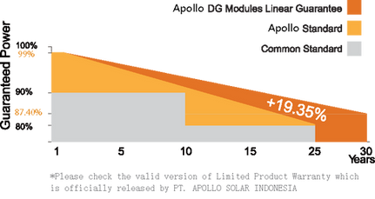
APM7-UHLDD144 (555-580W)
APM7-UHLDD144 Series
Key Features
16BB HALF-CELL N-Type TOPConBifacial Doouble Glass Monocrystalline PV Module
Excellent Cells Efficiency
MBB Technology reduce the distance between busbars and finger grid line which is benefit to power increase.
555-580W
22.44%
0.40%
Anti PID
Ensured PID resistance through the quality control of cell manufacturing process and raw materials.
POWER RANGE
MAXIMUM EFFICIENCY
YEARLY DEGRADATION
Bifacial Technology
12 YEARS PRODUCT WARRANTY
30 YEARS OUTPUT GUARANTEE
Up to 25% additional power gain from back side depending on albedo.
Better Weak Illumination Response
More power output in weak light condition, such as haze, cloudy, and early morning.
Adapt To Harsh Outdoor Environment
Resistant to harsh environment such as salt, ammonia sand, high temperature and high humidity envirnment.
IEC 61215/IEC 61730
ISO 14001: Emvironmental Management System
ISO 9001: Quality Management System
ISO45001: Occupational Health and Safety Management System
Excellent Quality Management System
Warranted reliability and stringent quality assurance well beyond certified requirements.
*As there are different certification requirements in different markets. Please contact your local Apollo sales representative for the specific certificates applicable to the products in the region in which the products are to be used.
KarMiTECH POWER

Slide 6
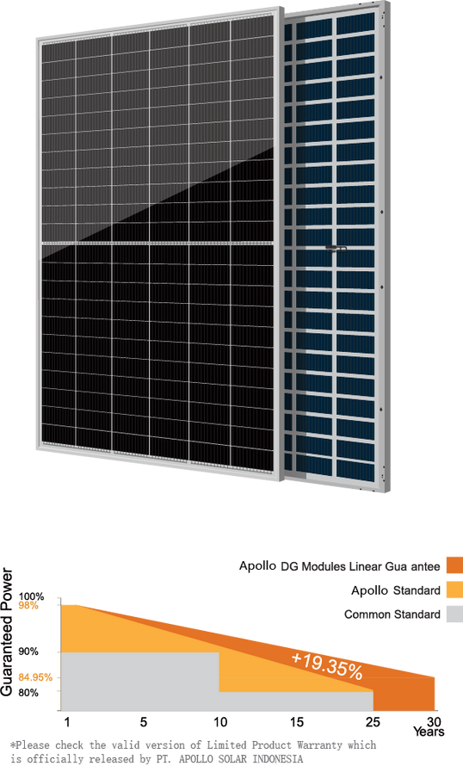
APM8-TPLDD132 Series (645-670W)
APM8-TPLDD132 Series
Key Features
12BB HALF-CELL Bifacial Double Glass Monocrystalline
PERC PV Module
Excellent Cells Efficiency
MBB Technology reduce the distance between busbars and finger grid line which is benefit to power increase.
645-670W
21.57%
0.45`%
POWER RANGE
MAXIMUM EFFICIENCY
YEARLY DEGRADATION
Anti PID
Ensured PID resistance through the quality control of cell manufacturing process and raw materials.
12 YEARS PRODUCT WARRANTY
30 YEARS OUTPUT GUARANTEE
Excellent Quality Management System
Warranted reliability and stringent quality assurance well beyond certified requirements.
Better Weak Illumination Response
More power output in weak light condition, such as haze, cloudy, and early morning.
IEC 61215/IEC 61730/UL 61730
ISO 14001: Environmental Management System
ISO 9001: Quality Management System
ISO45001: Occupational Health and Safety Management System
Adapt To Harsh Outdoor Environment
Resistant to harsh environment such as salt, ammonia sand, high temperature and high humidity envirnment.
*As there are different certification requirements in different markets. Please contact your local Apollo sales representative for the specific certificates applicable to the products in the region in which the products are to be used.
Bifacial Technology
Up to 25% additional power gain from back side depending on albedo.
KarMiTECH POWER

